Slide 1
Fairness in Smart contract biding
Pritom Rajkhowa

Slide 2
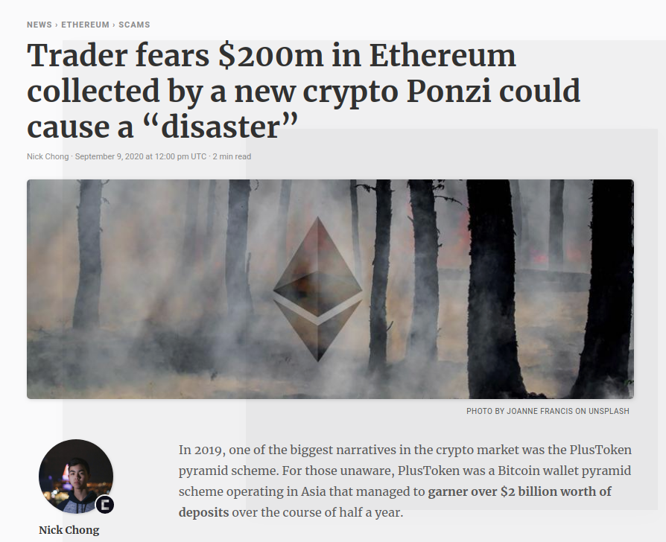
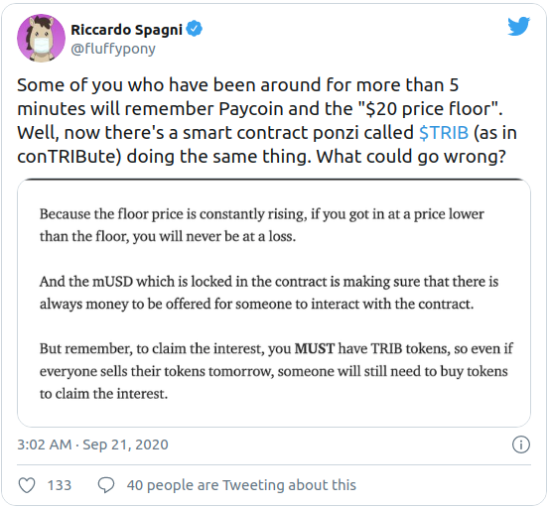
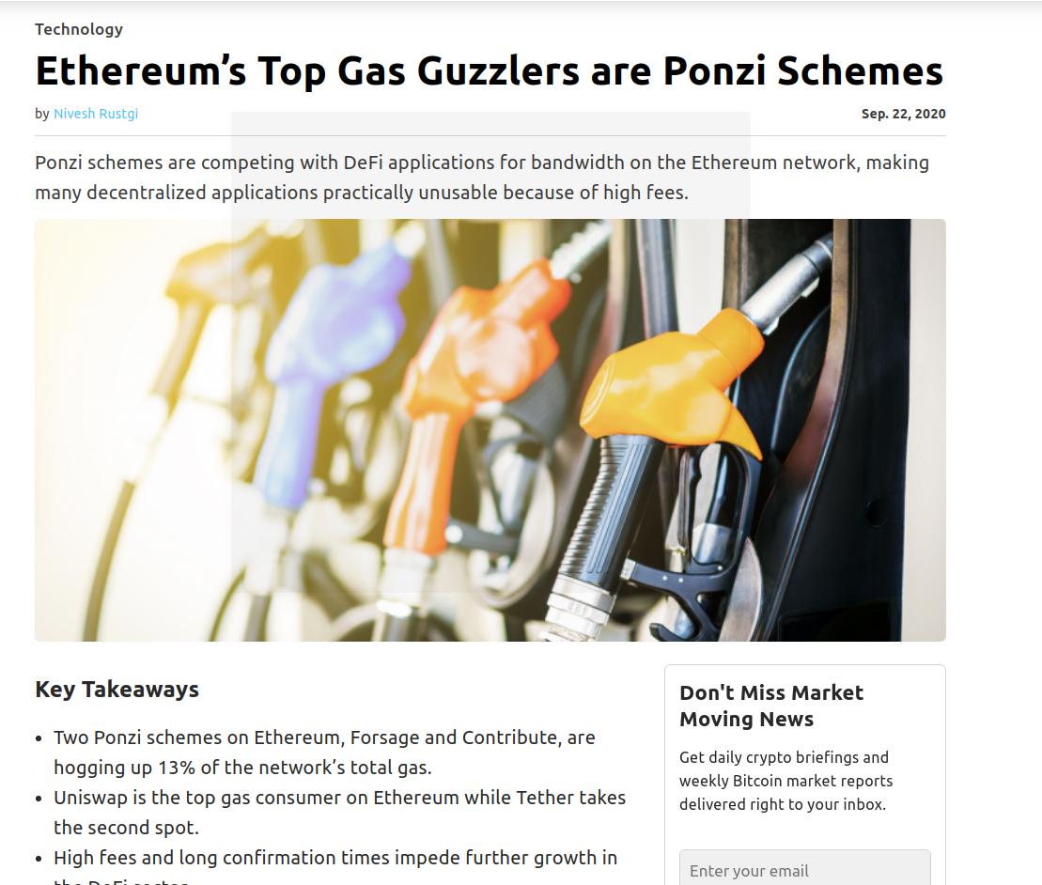
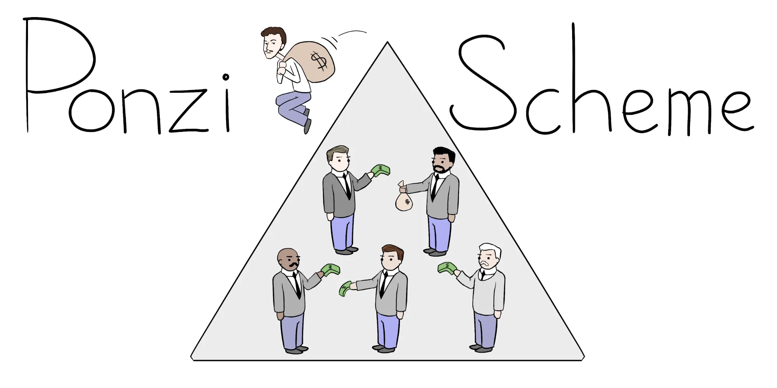
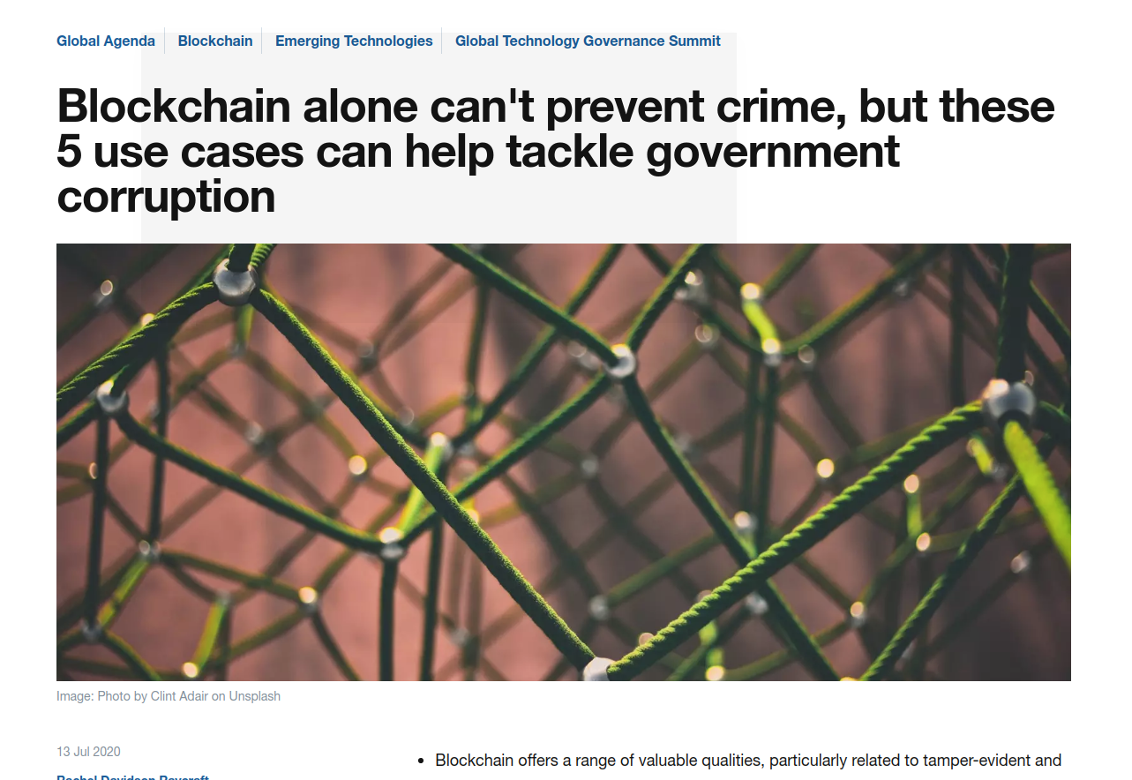
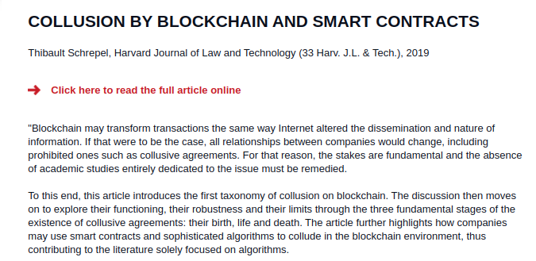
Fairness Issues
Public Procurement
Land Title Registries
Electronic Voting
Beneficial Corporate Ownership Registries
Grant Disbursements
Image curtsey: https://timesofindia.indiatimes.com; https://farming.co.uk
Notes:
But, fairness issues can exist in smart contract.
Fairness means if someone can gain advantage over others.
For example, the most infamous one is the Ponzi scheme.
Ponzi Schemes have been widely observed on Ethereum Smart Contract.
Moreover, Collusion in Smart Contract also poses threat to smart contract fairness.
especially for auctions and electronic votings.
//A Ponzi scheme is a form of fraud that lures investors and pays to earlier investors with funds from more recent investors.

Slide 3
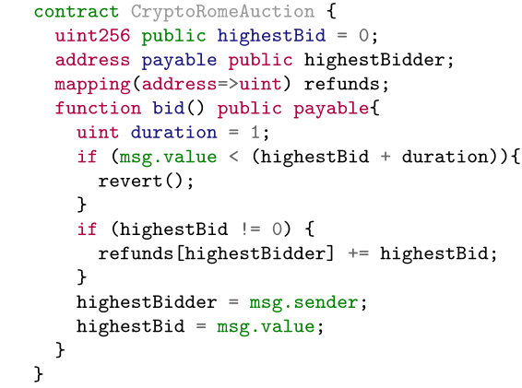
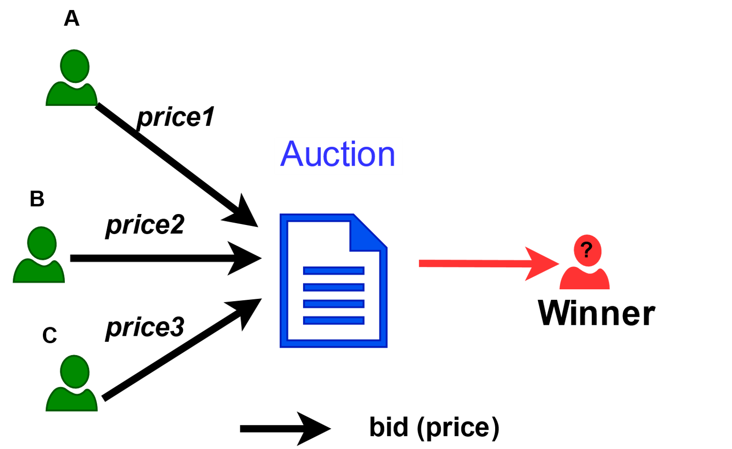
An Auction Smart Contract
Bidder | Valuation
A | 3
B | 4
C | 6
Open to all bidders
highestBidder wins the auction
Latecomer wins when bidding $1 more than the highestBid
Notes:
Here is a real world auction contract, CryptoRomeAuction.
The contract was written in Solidity, a popular smart contract programming language.
This contract implements an open auction.
-- the highest bidder wins the auction and
- the late comers can win if they bid one dollar more than the highest bid.
For an auctioned item, at the start of bidding, every bidder may have different valuation.
Given three bidders A, B, C,
A thinks the item valued 3 dollars, B thinks the item valued 4, and C thinks the item valued 6.
Notice that the bid price made by the bidder could be different from his valuation.

Slide 4
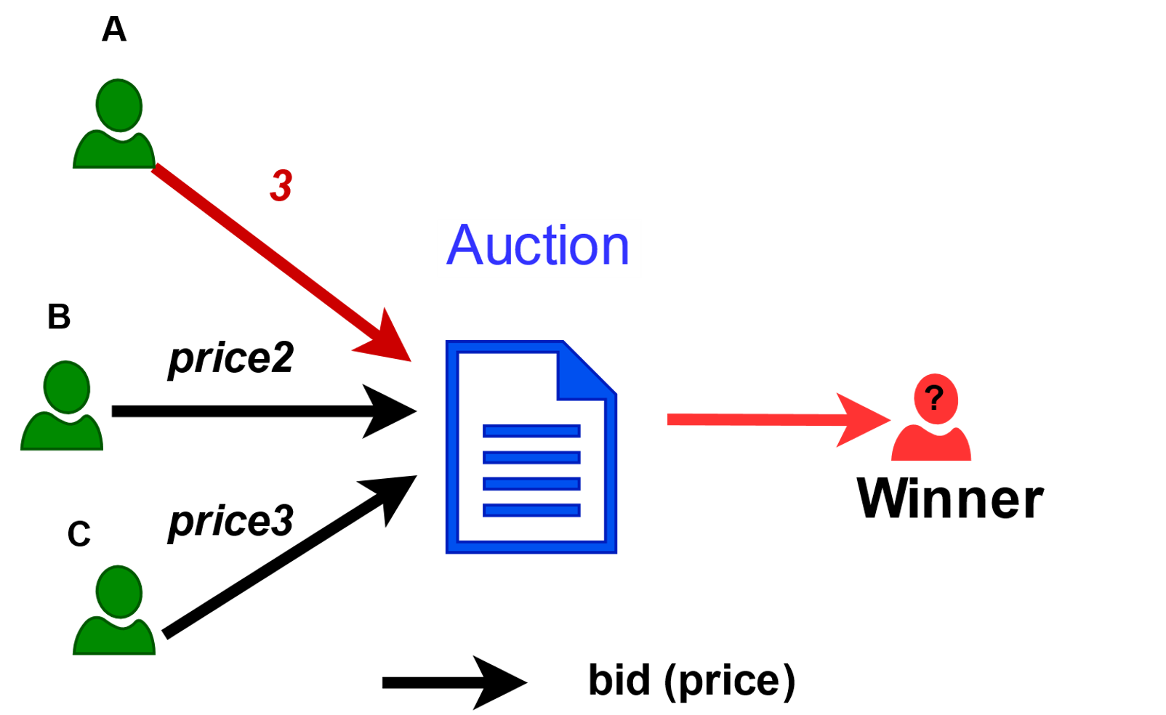
An Auction Smart Contract
Bidder | Valuation
A | 3
B | 4
C | 6
Open to all bidders
highestBidder wins the bid
Latecomer wins when bidding $1 more than the highestBid
3
A
3
3
0
1
Notes:
Suppose, User has a bid price 3.
To do that, the user calls the bid function;
then the condition rule inside the function will be checked.
Since the condition failed,
the next statement will be executed.
In the end, the contract updates the highest bidder to user A, the current highest bid to 3 dollar.

Slide 5
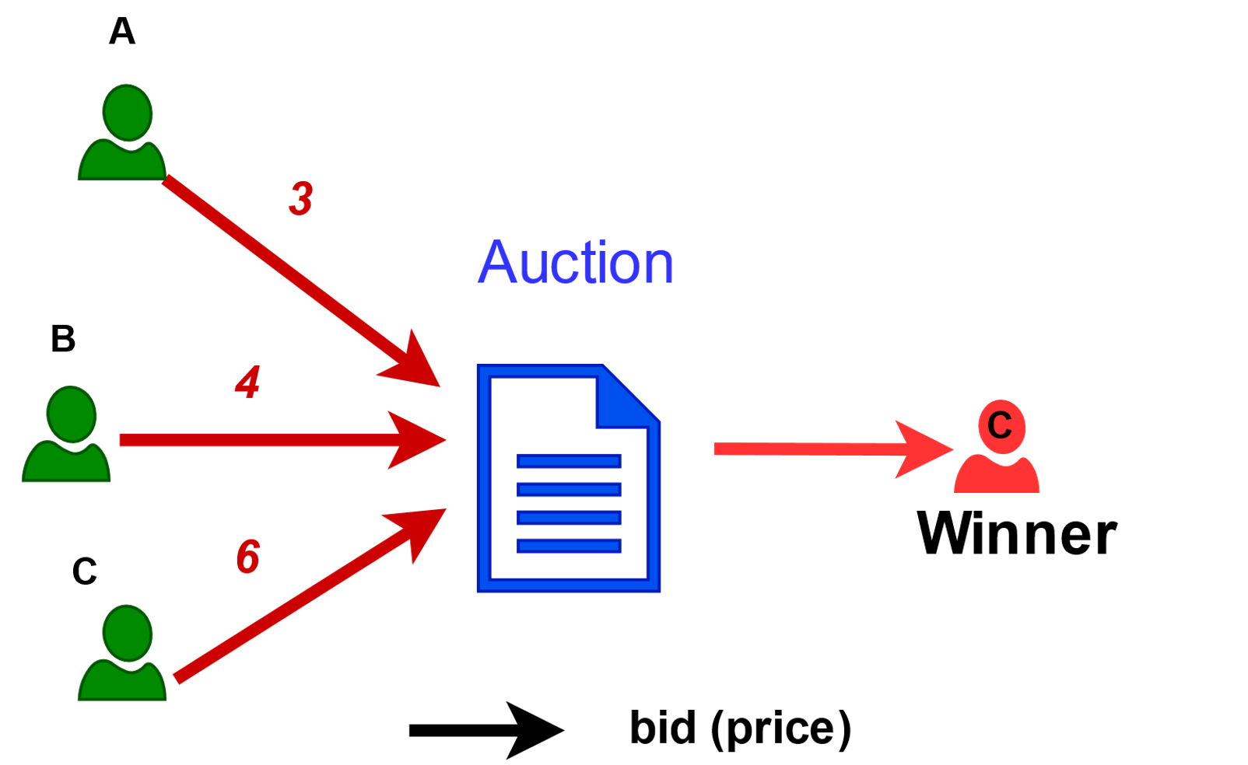
An Auction Smart Contract
Open to all bidders
highestBidder wins the bid
Latecomer wins when bidding $1 more than the highestBid
Bidder | Valuation | Bid Price
A | 3 | 3
B | 4 | 4
C | 6 | 6
3
6
C
4
6
C wins, and pays $6
Notes:
Similarly, user B, and user C can bid and update the variables: highest bidder and highest bid accordingly.
User B bids 4 and user C bids 6.
Finally, user C wins the auction and pays 6 as the auction clear price.
However, user C can pay less money to win the auction.

Slide 6
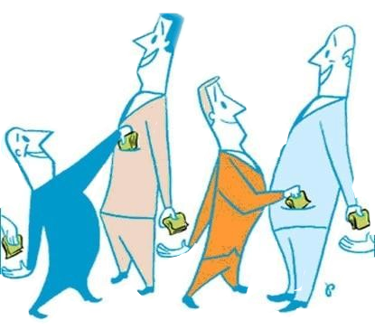
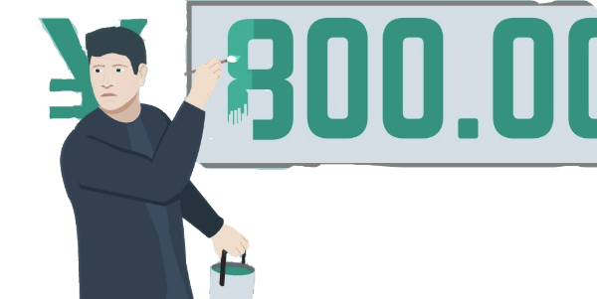
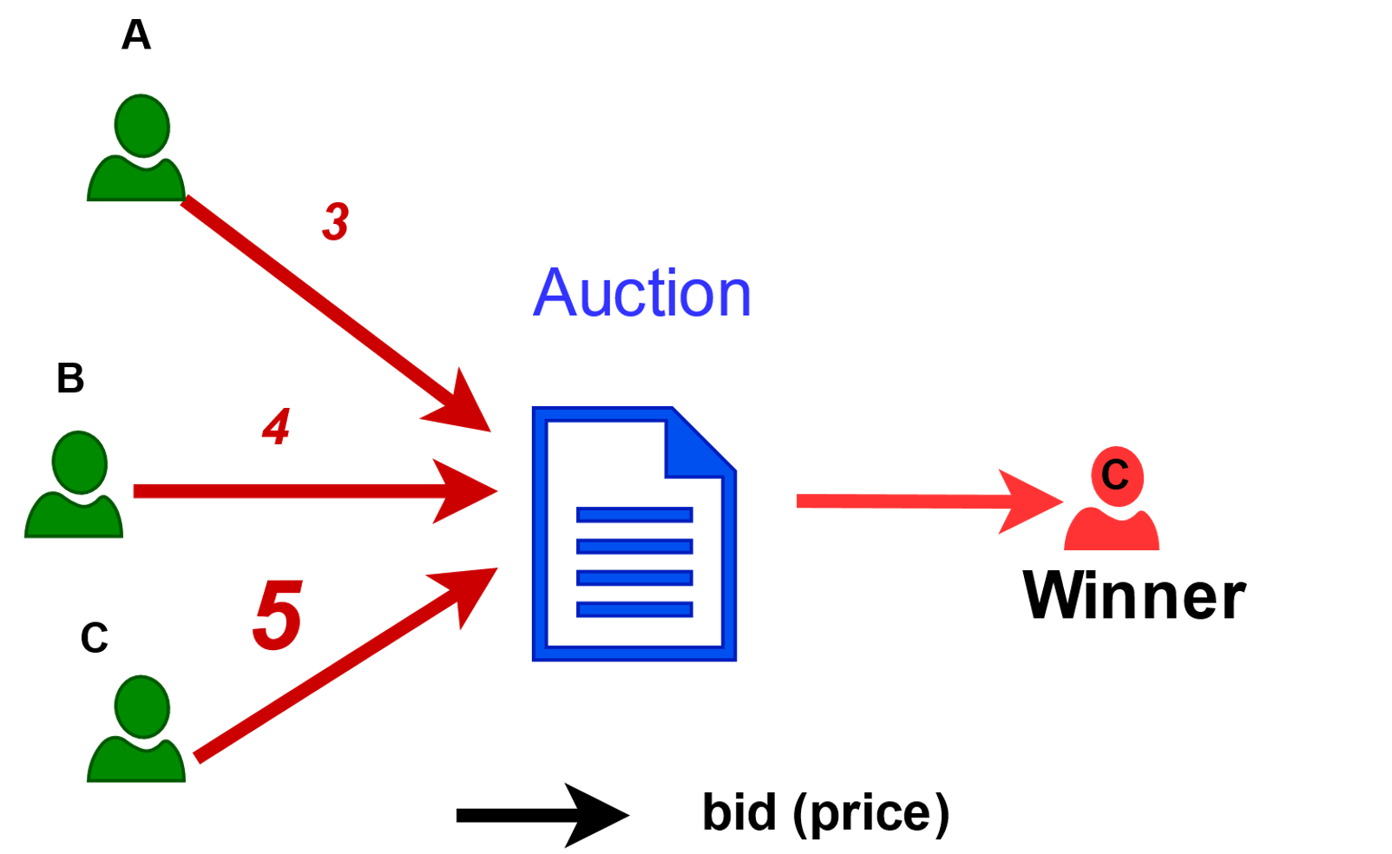
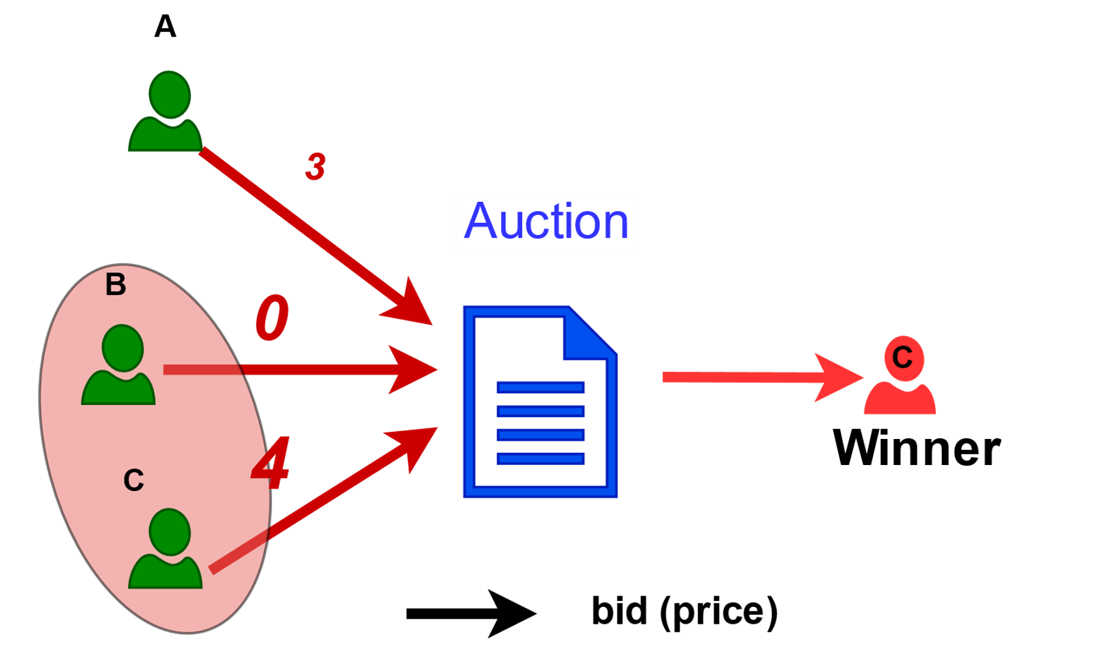
Threats to Smart Contract Fairness
Bidder | Valuation | Bid Price
A | 3 | 3
B | 4 | 0
C | 6 | 4
Bidder | Valuation | Bid Price
A | 3 | 3
B | 4 | 4
C | 6 | 5
1. Untruthful behavior
2. Collusion among players
3
4
C wins, and pays $5
C wins, and pays $4
Notes:
When user C is untruthful, C bids less than his valuation on the auction.
User C wins the auction. And only pay 5 dollar.
Moreover, the worst case is that user C colludes with user B, now user B bids 0, user C bids 4.
Finally, user C will win the auction but pay much less, at 4 dollar.
Apparently, these behaviors are not fair for user A, who acts honestly.

Slide 7
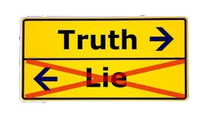



Smart Contract Fairness Verification
(Other fairness properties:
2-collusion freeness, optimality, efficiency)
Automated Checker
Smart Contract
Image curtsey: https://www.needpix.com/photo/185086/
Notes:
To find these fairness issues, we proposed an automated checker to verify if a smart contract satisfies a fairness properties.
As fairness could be too subjective,
we restrict to four fairness properties defined in game theory or say mechanism design theory.
The details can be checked in our paper.
We treat smart contracts as games between users and developers.
The verification result either indicates the contract is unfair through some counterexamples or fair using bounded property checking or unbounded verification.
I will show how we achieve that.

Slide 8
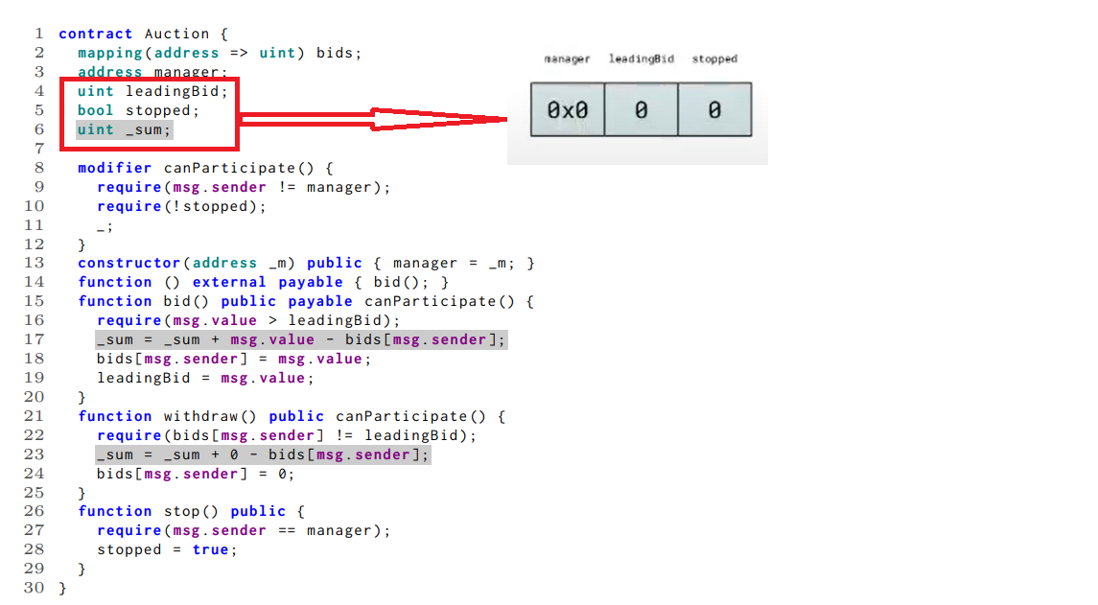
To uncover deep bugs spanning multiple transactions

Slide 9
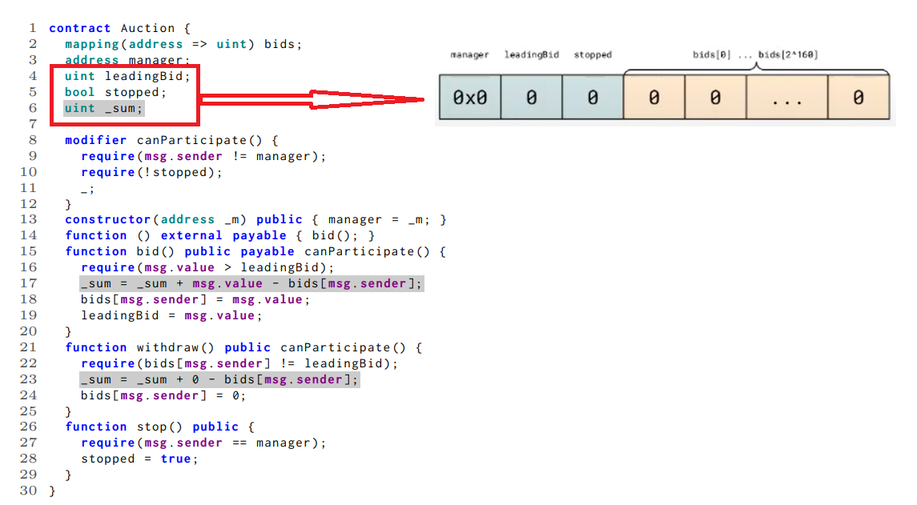
To uncover deep bugs spanning multiple transactions

Slide 10
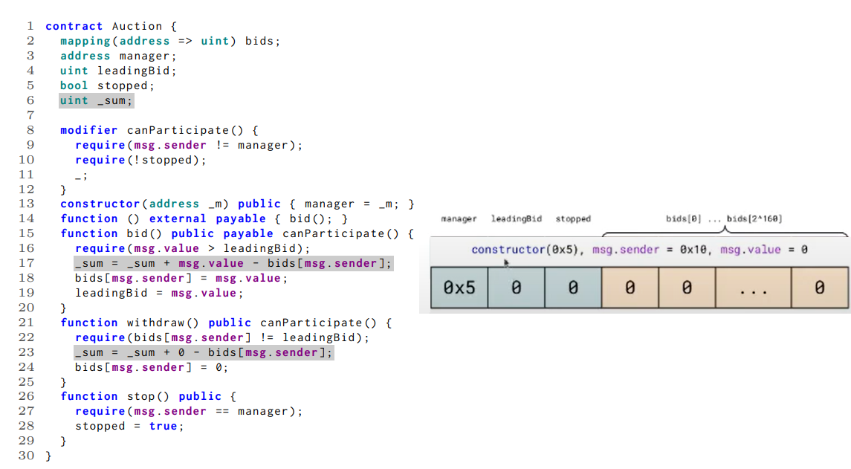
To uncover deep bugs spanning multiple transactions

Slide 11
Auction satisfies property (Properties are formalized and verified)
All bids are less than or equal to the recorded leading bid.
Any pair of non-zero bids are unequal.

Slide 12
RefundEscrow satisfies property (Properties are formalized and verified)
R1 If the state changes, then ownership has not been renounced.
R2 If close has been called, then all deposits are immutable.
R3 If close has been called, then enableRefunds has not been called.
R4 If beneficiaryWithdraw has been called, then the balance of the refund escrow is 0, otherwise the balance is the sum of all deposits.
R5 If enableRefunds has not been called, then all deposits are increasing.

Slide 13
Thanks

